Slide 1



CSE5010 Final Project Presentation MIMO-SAR Based Soil Wetness Detection
Jinyi Cui 12432661
Shengding Liu 12110813
Haoxian Liu 12111515
2024.12.24
Group member:
Group work : 1:1:1

Slide 2
Content
Topic source
Related works
Project contents and targets
Project Progress
Conclusion

Slide 3
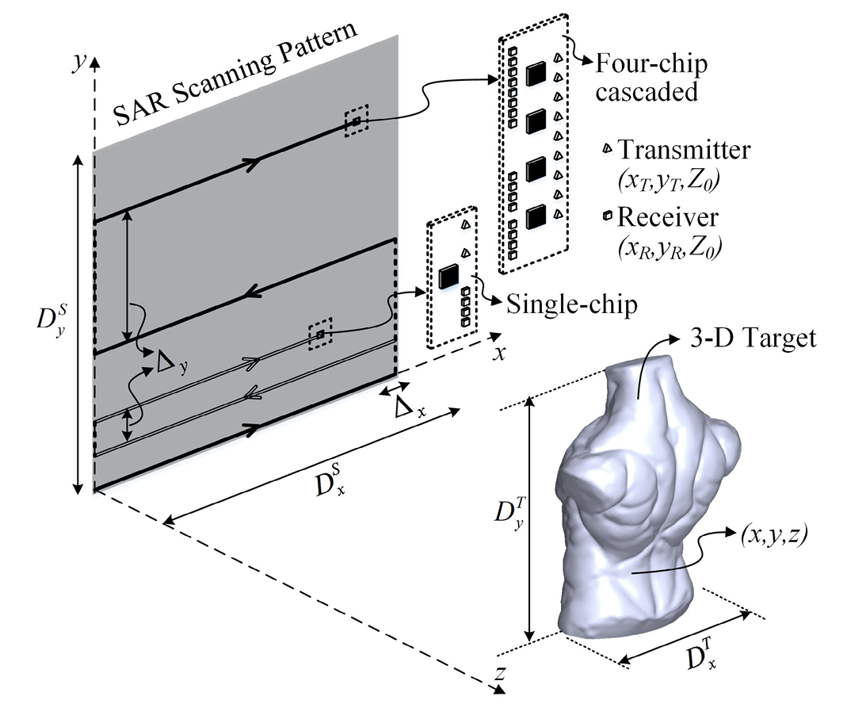
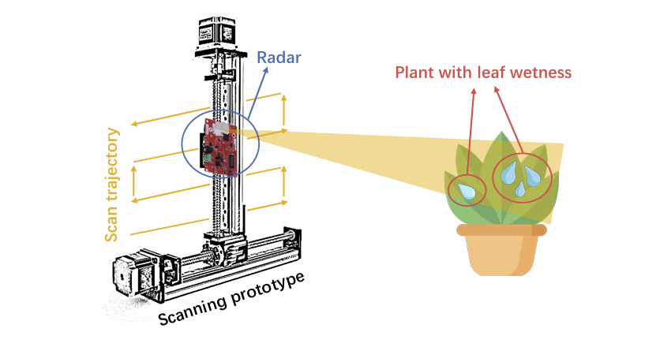
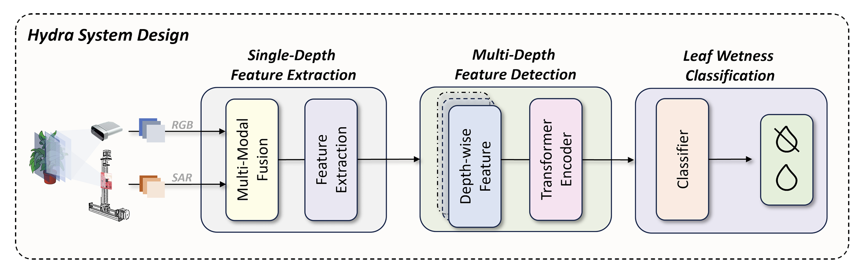
Topic Source​
Development and Demonstration of MIMO-SAR mmWave Imaging Testbeds
Hydra: Accurate Multi-Modal Leaf Wetness Sensing with mm-Wave and Camera Fusion
Needs:
Disaster prevention needs
Smart agriculture needs
The geometry of the MIMO-SAR imaging configuration^{[1]}
Leaf wetness detection with mmLeaf^{[2]}
Hydra Overview^{[3]}
[1] Yanik, M. E., Wang, D., & Torlak, M. (2020). Development and demonstration of MIMO-SAR mmWave imaging testbeds. IEEE Access, 8, 126019-126038
[2] Gan, M., Liu, Y., Liu, L., Wu, C., Dong, Y., Zeng, H., & Cao, Z. (2023, June). Poster: mmLeaf: Versatile Leaf Wetness Detection via mmWave Sensing. In Proceedings of the 21st Annual International Conference on Mobile Systems, Applications and Services (pp. 563-564).
[3] Li, G., Zeng, H., Guo, H., Ren, Y., Dixon, A., Cao, Z., & Li, T. (2024, November). PiezoBud: A Piezo-Aided Secure Earbud with Practical Speaker Authentication. In Proceedings of the 22nd ACM Conference on Embedded Networked Sensor Systems (pp. 564-577).
Notes:
Disaster prevention needs - Extreme weather events requires wide-range, real-time soil monitoring​
​
Precision Agriculture needs - Intelligent irrigation decision-making mechanism for effective agriculture works​
​
Disaster prevention needs, Technological development - MIMO significantly improve channel capacity and anti-interference capability of traditional SAR​

Slide 4
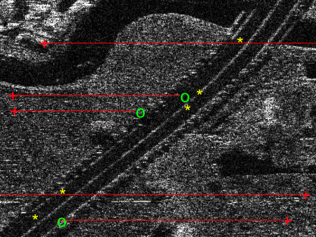
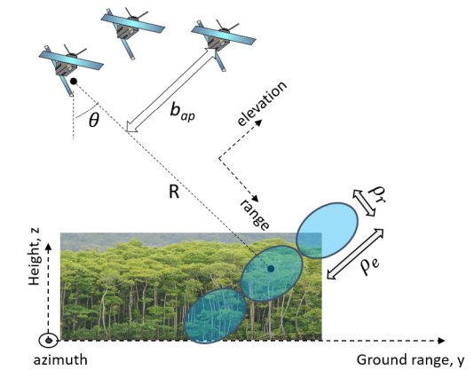
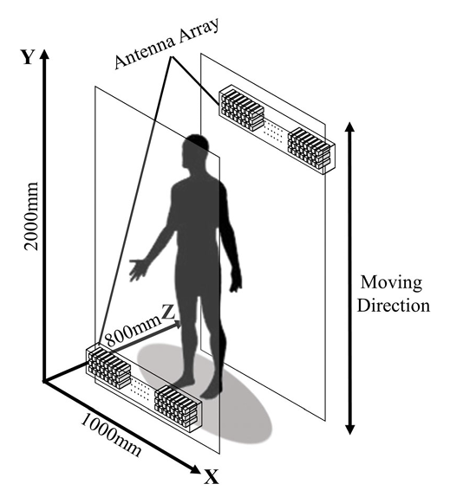
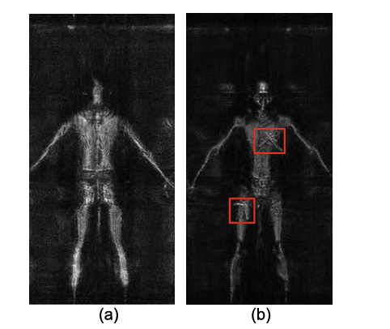
Related Works – MIMO-SAR
Ground moving target detection and clustering^{[1]}
Resolve the vertical structure of natural media^{[2]}
MIMO-SAR security inspection system^{[3]}
[1] L. Wang et al., "Ground Moving Target Indication and Relocation in Spaceborne MIMO-SAR Systems," in IEEE Transactions on Geoscience and Remote Sensing, vol. 61, pp. 1-25, 2023, Art no. 5210525, doi: 10.1109/TGRS.2023.3286388.
[2] S. Tebaldini, M. Manzoni, L. Ferro-Famil, F. Banda and D. Giudici, "FDM MIMO Spaceborne SAR Tomography by Minimum Redundancy Wavenumber Illumination," in IEEE Transactions on Geoscience and Remote Sensing, vol. 62, pp. 1-19, 2024, Art no. 5207119, doi: 10.1109/TGRS.2024.3371267.
[3] Su, B., & Yuan, M. (2023). Object recognition for millimeter wave MIMO-SAR images based on high-resolution feature recursive alignment fusion network. IEEE Sensors Journal, 23(14), 16413-16427.

Slide 5
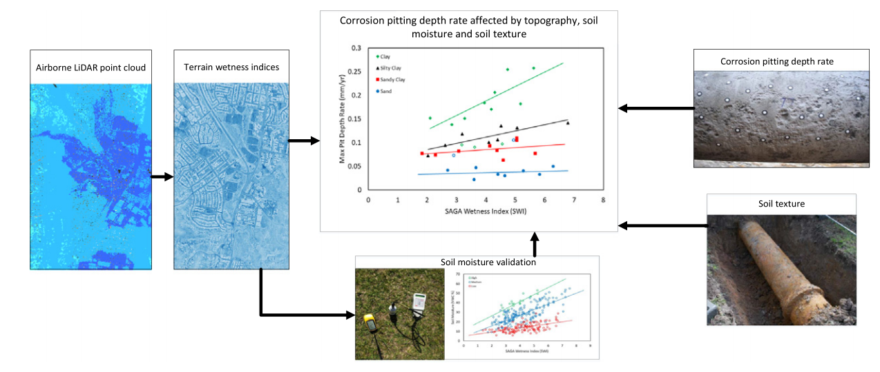
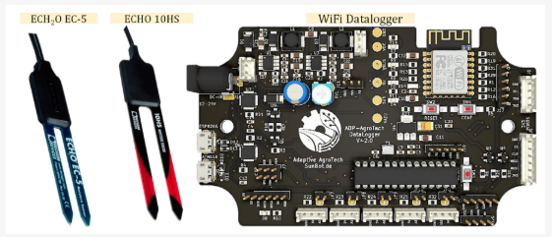
Related Works - Soil Wetness Detection
Measure directly soil moisture using a soil moisture sensor
Use LiDAR to capture terrain data and calculate the SAGA Wetness Index (SWI) for precise assessment of moisture distribution^{[1]}
[1] David Bretreger, In-Young Yeo, Robert Melchers, Terrain wetness indices derived from LiDAR to inform soil moisture and corrosion potential for underground infrastructure, Science of The Total Environment, Volume 756, 2021

Slide 6
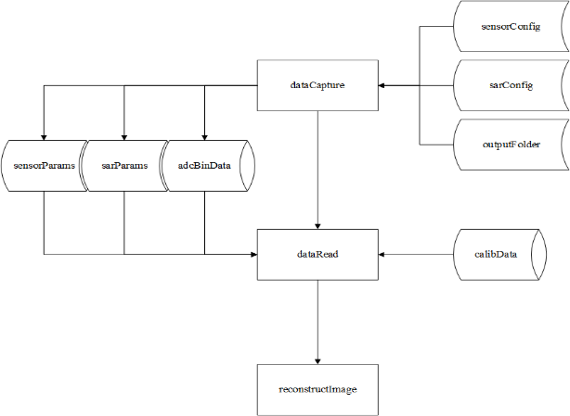
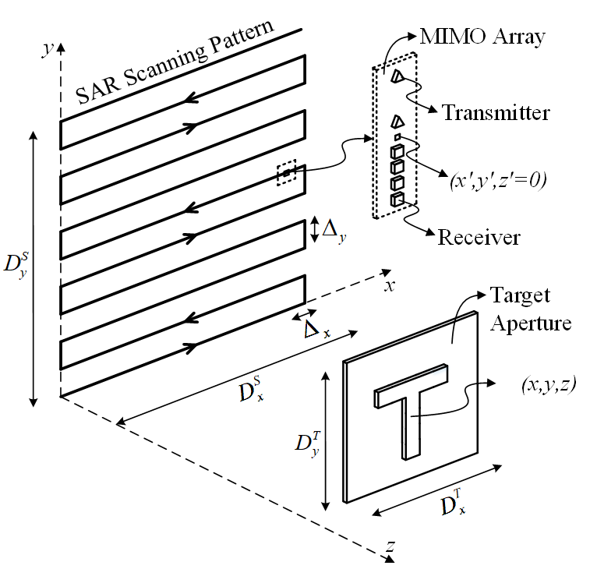
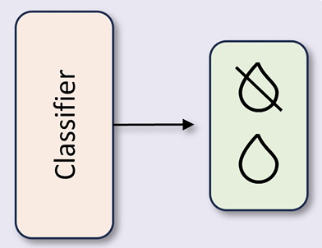
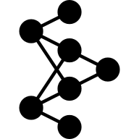
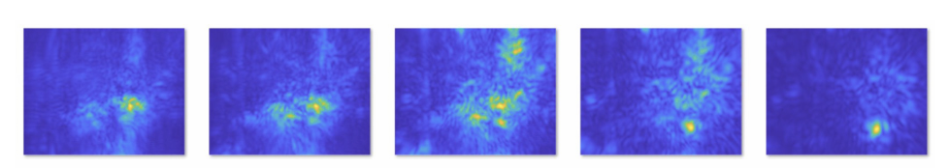
System Design​
High-level system
architecture
High-level software
architecture
Experimental scenario
Data collection
ResNet classifier
Soil wetness detection

Slide 7
Project Content and Targets​
Hardware:
Setup the included platform and deploy locally
Design and run experimental scenarios
Software:
Define Sensor/SAR parameters and modify the source code
Collect high-quality mmWave radar data
Perform preprocessing and reconstruct the 3D-Image
Build an effective classification network for images
Summarize research results and generate reports
Targets:
Reproduce MIMO-SAR system
Build a high-quality dataset and an effective classification network for soil wetness detection
Extend our work to boarder applications (optional)
7

Slide 8
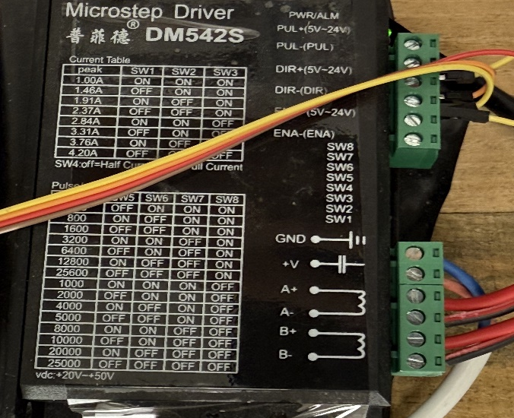
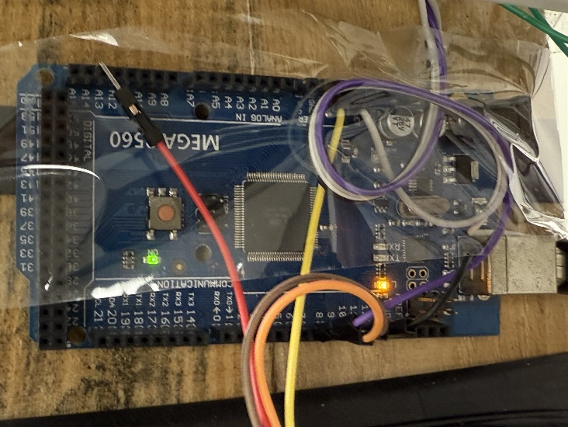
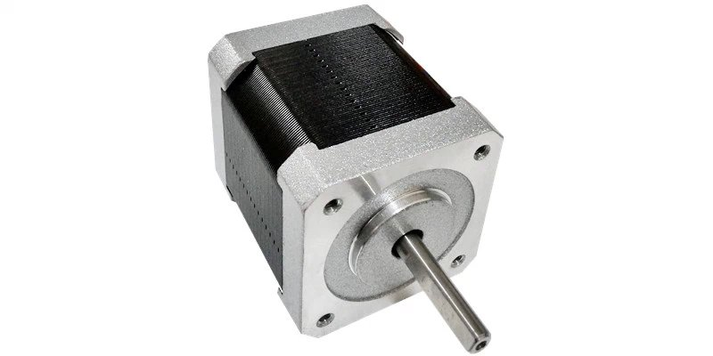
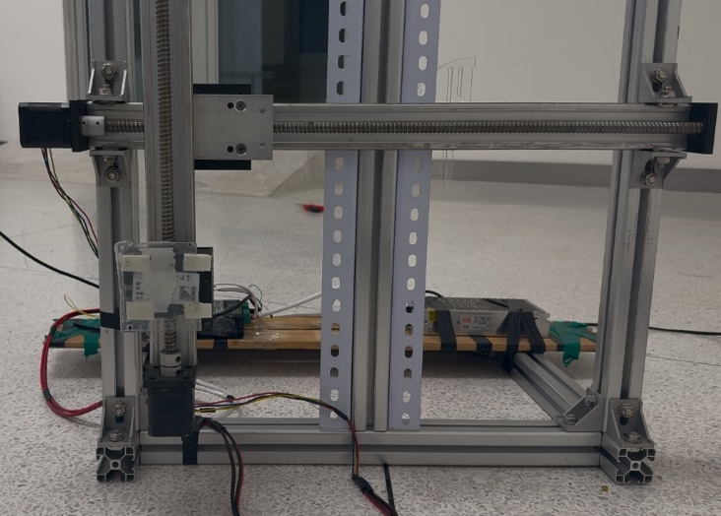
2D Scanner Platform
Driving Stepper Motors with the DM542S Microstep Driver.
Controlling Stepper Motor Motion with the Arduino MEGA 2560 Development Board.
The pulse frequency is set to 1000Hz to achieve a speed of 20mm/s.
Arduino MEGA 2560
42BYGH4812 Motor
2D Scanner Platform
DM542S Microstep Driver
8
Notes:
接下来，我对我们这个项目的具体实现和成像结果进行讲述，希望对雷达成像感兴趣的同学，在听完我们的报告以后，也能成功复现出来，首先是我们的硬件部分，第一个是2D Scanner的平台，主要包含了变压器，步进电机，步进电机驱动器，2D导轨和Ardiuno这几个组件，我们使用Ardiuno Mega作为我们的微控，DM542S作为我们的驱动器，使用了42步进电机，一句话概括我们这个部分做的事情，就是使用Ardiuno程序控制DM542S驱动42步进电机实现精确控制

Slide 9

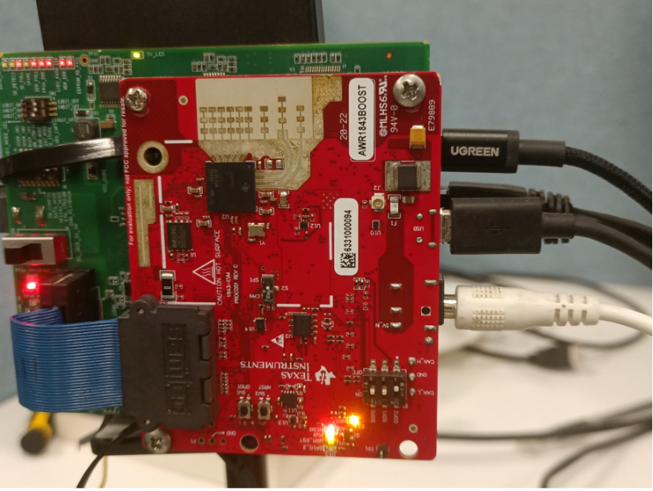
Raw Data Capture
Capturing mmWave Radar raw data with AWR1843Boost and DCA1000 EVM.
Using TDMA arrays (3 transmitters and 4 receivers).
The scanning range is 400 mm by 400 mm, and the scanning speed is 20mm/s.
2D Scanner Platform
mmWave Radar Device
9
Notes:
第二部分是原始数据采集部分，我们使用了AWR1843Boost和DCA1000EVM进行雷达信号的收发与采集，使用TDMA的MIMO技术，其中扫描范围是400*400，扫描速度是20mm/s，其实对于MIMO-SAR而言，原始数据的采集是至关重要的一环，因为涉及到如何分类不同基站的数据，后面我会讲这里面的一些challenge和

Slide 10

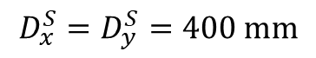
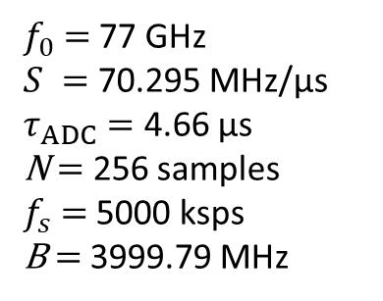
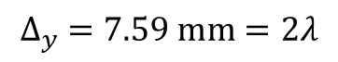
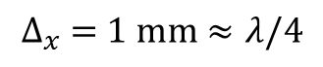
Imaging Procedure
Data collection is performed by moving a single-chip MIMO radar along a trajectory in $x−y$ plane
MIMO array topology of AWR1843-Boost (3 TX, 4 RX )
SAR parameters:
$$D_{x}^{S}=D_{y}^{S}=400 mm$$
$$∆_{x} =1 mm≈λ/4$$
$$∆_{y} =7.59 mm=2λ$$
Same chirp parameters:
$f_{0}$ $=$ 77 GHz
$S =$ 70.295 MHz/µs
$τ_{ADC}=$ 4.66 µs
N $=$ 256 samples
$f_{s}$ $=$ 5000 ksps
B $=$ 3999.79 MHz
10
Notes:
这个是我们成像的一个大致流程，我们的雷达会沿着我们的2维的导轨进行弓形扫描，我们使用3发4收，TDMA的方式，形成了一个大小为12的一个虚拟天线阵列，然后截取水平的8根虚拟天线作为有效的虚拟天线阵列。
由于远场效应，这里对每一对tranceiver进行了中点近似，因此形成的虚拟天线阵列式真实天线阵列尺度的一半，也就是说我虚拟天线之间的间隔现在是lambda/4，所以x轴的步长就是lambda/4，y轴的步长就是8*….，就是2；lambda，然后下面是我们的chirp的profile

Slide 11
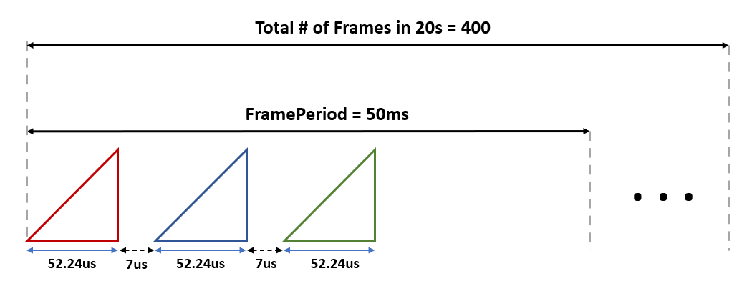
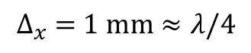
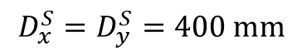
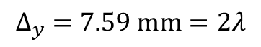
Accurate Control of Sampling and Preprocessing of Raw Data
Data collection is performed by moving a single-chip MIMO radar along a trajectory in $x−y$ plane
SAR parameters:
Crop the raw data captured during $∆_{y}$
$$D_{x}^{S}=D_{y}^{S}=400 mm$$
$$∆_{x} =1 mm≈λ/4$$
$$∆_{y} =7.59 mm=2λ$$
Adjust the relationship between the speed and sampling
TX0
TX1
TX2
11
Notes:
接下来我会讲一下在数据采集和预处理中的两个挑战，第一个是需要调整速度与采样的关系，

Slide 12
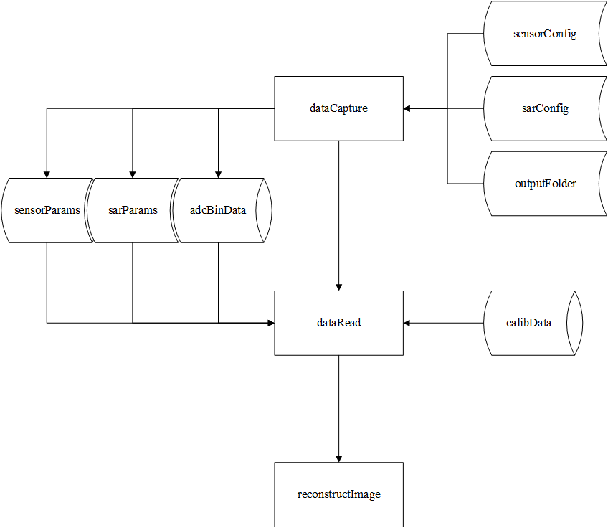
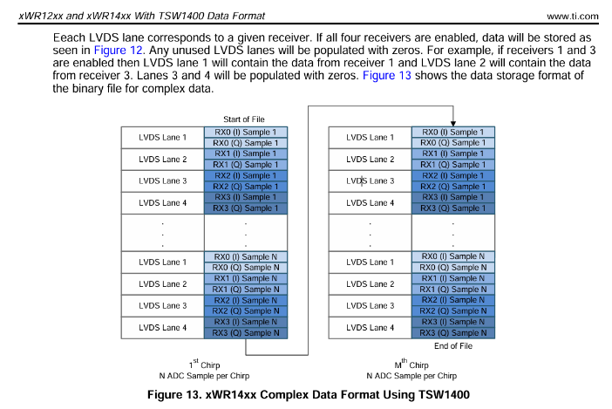
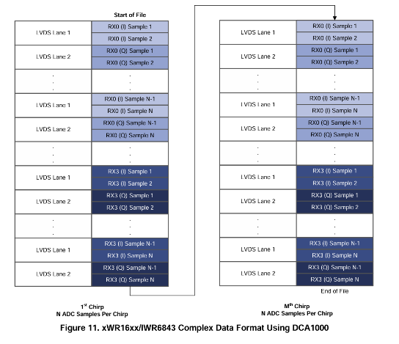
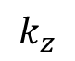
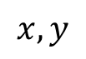
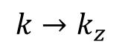
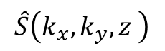
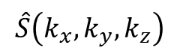
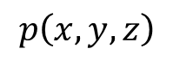
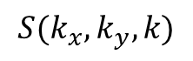
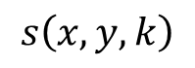
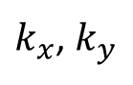
High Level Software Architecture Based on MIMO-SAR Toolbox
Modify the interface function and data read function
Extract the core algorithms of reconstructing image
$$s\left(x,y,k\right)$$
$$x,y$$
FFT2
$$S(k_{x},k_{y},k)$$
mmWave Studio
Ardiuno IDE
Matlab
Python
$$k→k_{z}$$
Interpolate
$$\hat{S}\left(k_{x},k_{y},k_{z}\right)$$
$$k_{z}$$
FFT
$$\hat{S}\left(k_{x},k_{y},z \right)$$
$k_{x}$, $k_{y}$
IFFT2
$$p\left(x,y,z\right)$$
3-D image formation
12

Slide 13
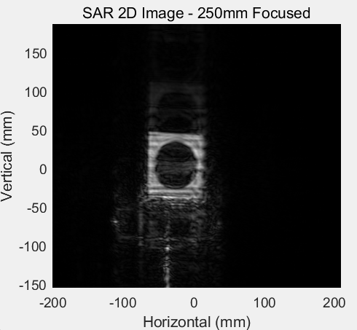
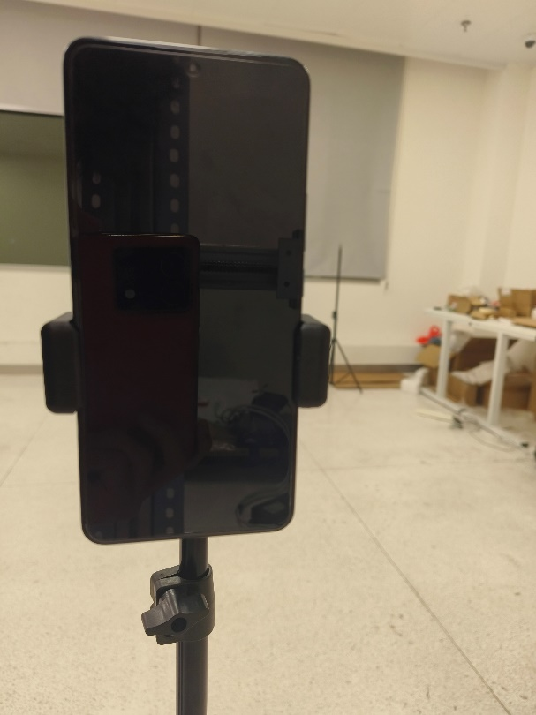
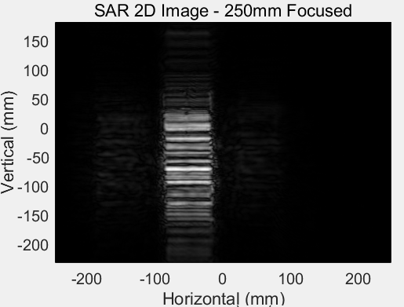
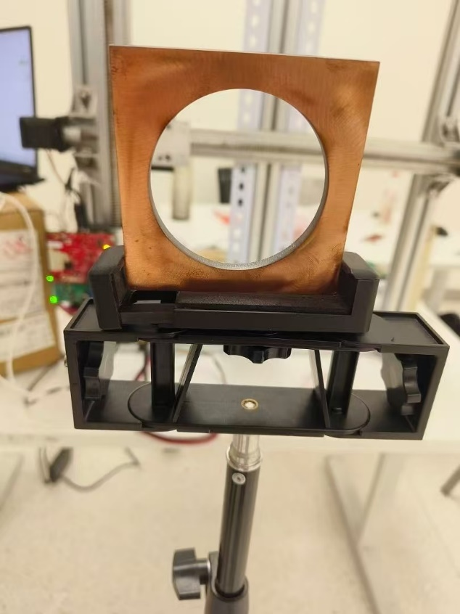
Imaging Result
For the two objects measured, the hollow square piece of iron and the mobile phone, the maximum error in measurement does not exceed 3mm.
The Smartphone’s camera.
80mm
78mm
163.1mm
77mm
75mm
166mm
75mm
76.15mm
13

Slide 14
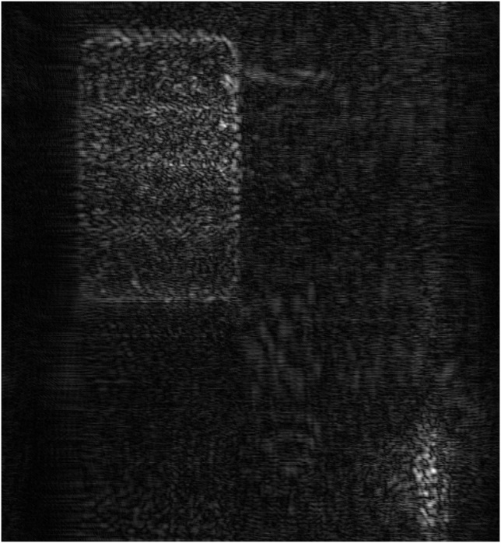
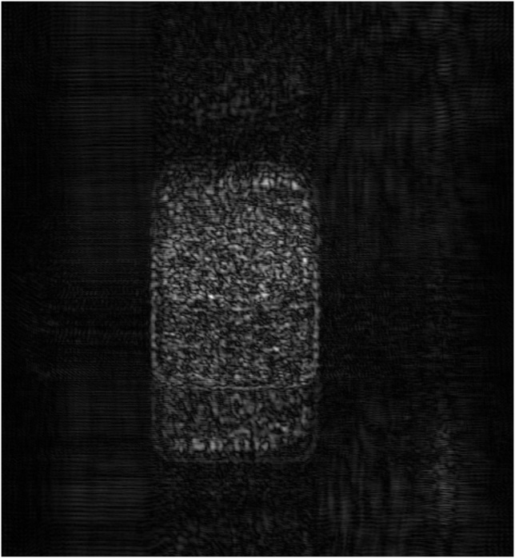
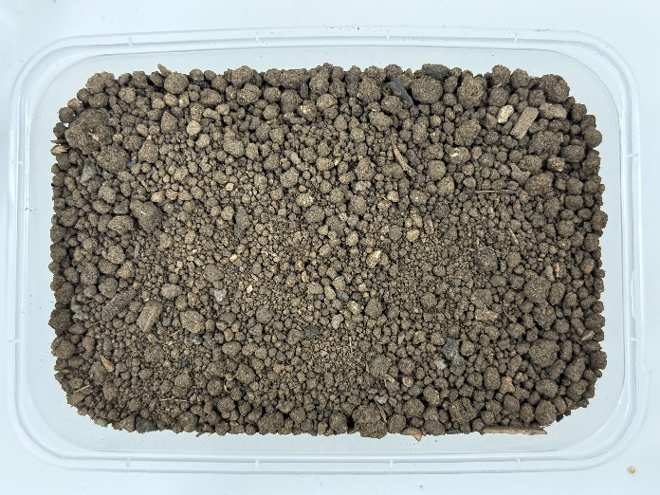
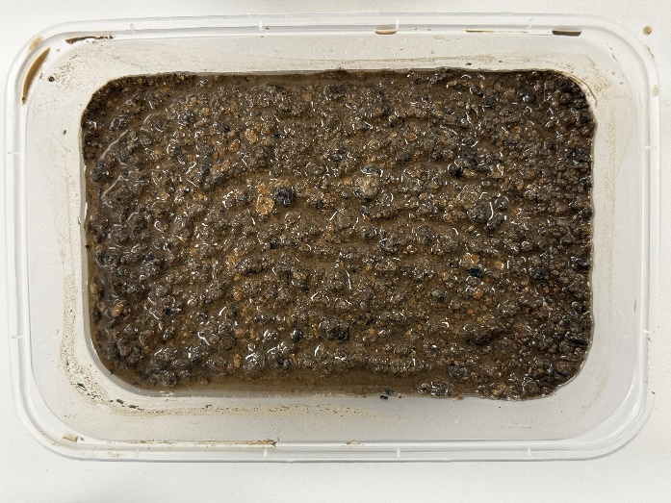
Soil Imaging Result
Imaging soil with different humidity levels varies in brightness, the higher the humidity, the greater the brightness of the image
Dry Soil
Dry Soil Imaging Result
Wet Soil
Wet Soil Imaging Result
14

Slide 15
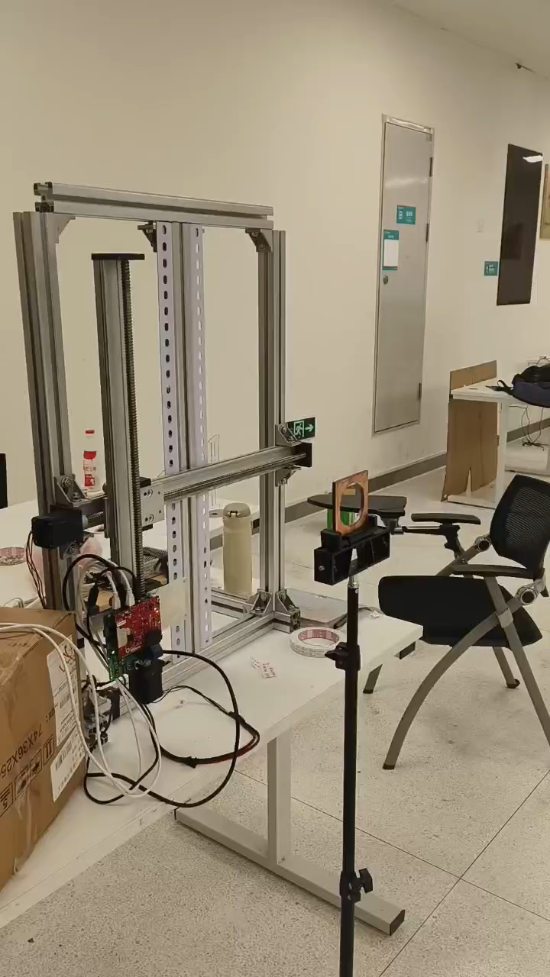
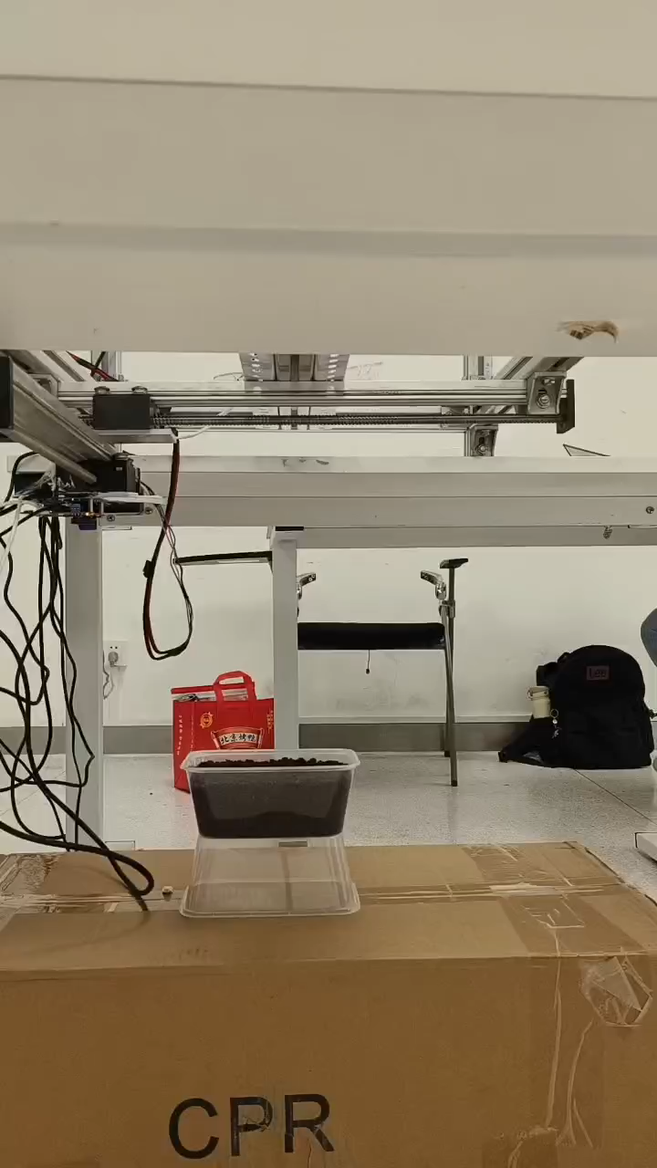
Demo Showcase of Data Collection
MIMO-SAR Imaging of hollow iron piece in square
MIMO-SAR Imaging of Soil
3 ✖ Speed Playback
16 ✖ Speed Playback
15

Slide 16
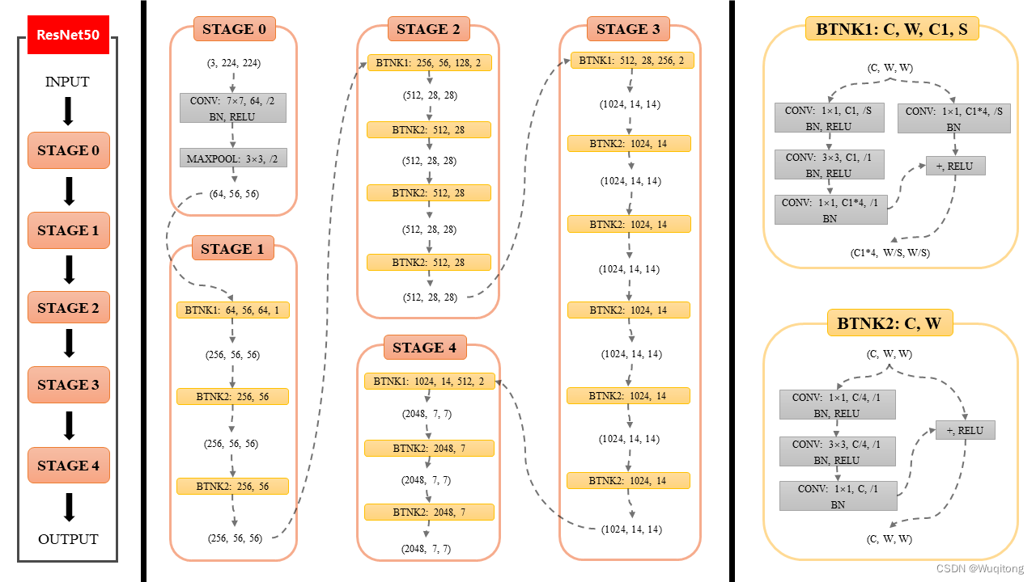


Dataset and Classification
model = torchvision.models.resnet50(weights = None)
Self-collected Soil Dataset
ResNet-50 Classifier^{[1]}
Classifying Result
[1] He, Kaiming, et al. "Deep residual learning for image recognition." Proceedings of the IEEE conference on computer vision and pattern recognition. 2016.
16
Notes:
我们分别对干的土壤和湿的土壤做了八组实验，然后取了土壤不同深度的图像作为输入，因为实验的任务量比较大，做一次实验至少20min，并且需要人的高强度参与，因此我们进行了数据增强，一共得到了800张图像作为数据集，然后搭建了Res50残差网络作为分类器，最终。。。。。

Slide 17

Discussion:
Modeling improvement: For more reasonable applications, we can model soil wetness detection as a regression problem. (How to get tag/GT)
Data collection: Driving the 2D scanner and collecting data for imaging is time-consuming and requires strict time synchronization. It is reasonable to use a controller to do automatical work.
Data diversity: The data set should include a variety of soil conditions (including possible foreign matter) to ensure generality.
Result Analysis and Discussion
Achieving 100% accuracy can primarily be attributed to the following factors:
Problem Modeling: In this project, soil wetness detection was formulated as a binary classification problem, simplifying the task and reducing potential ambiguity.
Dataset: The dataset lacked diversity, and data augmentation techniques were applied to compensate for this limitation, given the constraints of the workload.
ResNet-50: The ResNet-50 architecture, being a well-designed and widely recognized model for classification tasks, significantly contributed to the high performance.
Discussion:
Modeling Improvement: For more practical and applicable scenarios, soil wetness detection could be modeled as a regression problem, which provides more granular insights. (This requires an effective method to obtain accurate labels/ground truth.)
Data Collection: Operating the 2D scanner and acquiring imaging data is a time-intensive process that demands precise time synchronization. Employing a controller to automate the data collection process would be a more efficient and reliable approach.
Data Diversity: To ensure the model's generalizability, the dataset should encompass a wide range of soil conditions, including the presence of potential foreign objects or varying environmental factors.
17

Slide 18
Conclusion
\
Effective Imaging Performance: Using commercial off-the-shelf (COTS) equipment, MIMO-SAR can achieve impressive imaging performance, demonstrating its practicality in various scenarios.
Qualitative Soil Moisture Analysis: MIMO-SAR proves effective in conducting qualitative analysis of soil moisture, showcasing its potential for environmental and agricultural applications.
Experimental Challenges: The use of MIMO-SAR demands strict experimental conditions, making it labor-intensive and requiring meticulous effort.
Static Environment Requirement: Due to the long data acquisition time, MIMO-SAR requires the surrounding environment to remain static, which limits its applicability in dynamic settings.
18

Slide 19
Time schedule​
Weeks 12–13: Set up the platform and implement MIMO-SAR imaging
Week 14: Conduct data collection and develop a classification network
Week 15: Explore potential applications of the project
Week 16: Organize research results and prepare the final report
19

Slide 20


Open Source
See more details at https://github.com/SendingA/MIMO_SAR_Based_Soil_Wetness_Detection
You can build up one platform leveraging all the hardware components mentioned above and collect your own MIMO-SAR data, which may be quite challenging and exhausting.
Therefore, we provide you with the following data to make you have a general idea about what the imaging is like.
You can access these data shared by Baidu Disk ：MIMO-SAR Data through the following link.
- Link: https://pan.baidu.com/s/1aAp8LxT2ngH5ruKbu5GJuw?pwd=3ww1
- Password: 3ww1

Slide 21
THANK YOU！
Q & A

Slide 22


APPENDIX
42BYG混合式步进电机_步进电机,步进电机驱动器-常州康达通用电气有限公司
42 BYG H4812 motor

